Slide 1
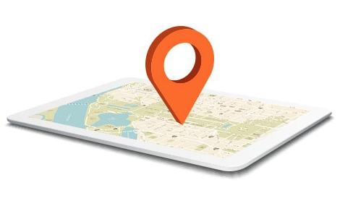
Evaluate Techniques for Wifi Locationing
Maral Jamali Data Scientist at Alert Analytics

Slide 2
Project Goals
Evaluate the application of machine learning techniques to the problem of indoor locationing via wifi fingerprinting

Slide 3
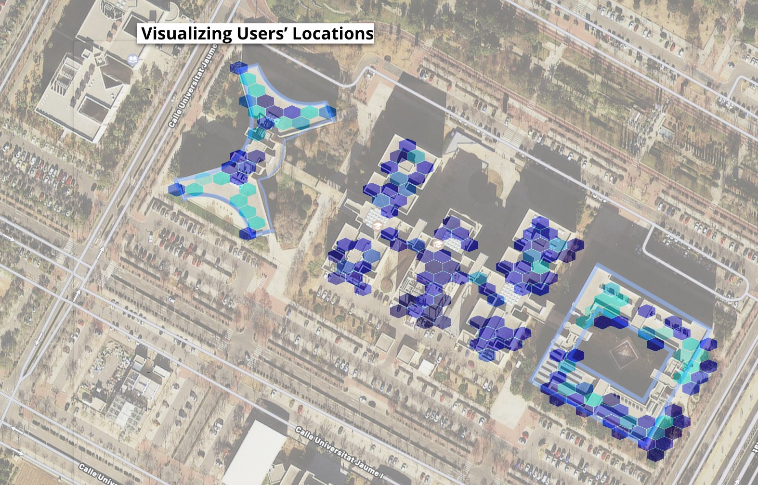
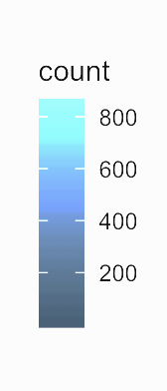
Project Overview
Visualizing User’s Locations
Data Source: UC Irvine
Building Location: Universitat Jaume I in Castellón, Spain
Number of Columns: 529
Number of Rows: 19937

Slide 4
Challenges and Limitations
Challenge | Solution
The frequency of factors (dependant variable) is very low | Sampling the data based on Builiding ID
Dataset is very large and model running time is long | Assigning new cores to R using (registerDoParallel) to decrease data processing time

Slide 5
Project Workflow
Obtained data from https://archive.ics.uci.edu/ml/datasets/ujiindoorloc
Data CleanUp & EDA
Pre Processing and Feature Engineering
Data Modeling
Resampling and Model Eval
Recommendations
Decision Tree
Random Forest
SVM

Slide 6
Decision Tree Model Evaluation
Building Number | Accuracy | Kappa
Building 0 | 0.79% | 0.79%
Building 1 | 0.89% | 0.94%
Building 2 | 0.90% | 0.90%

Slide 7
Random Forest Model Evaluation
Building Number | Accuracy | Kappa
Building 0 | 0.87% | 0.87%
Building 1 | 0.94% | 0.89%
Building 2 | 0.81% | 0.81%

Slide 8
Conclusion
Our confidence level in both RF and C5.0 models is pretty high while SVM turned out to be computationally inefficient compared to the other two models.
We recommend using Random Forest to conduct this analysis and predict users’ locations based on wifi fingerprinting at the registerDoParallel.

